Slide 1

Python for
Data Science
1
www.BigDataTrunk.com

Slide 2

Welcome to
Python for Data Science
PRE-WORK
Sign-in for Attendance
Pick your Name tag
Download Anaconda if using your laptop. (Python v3.x)
https://www.anaconda.com/distribution/
Download material from zip in email
https://tinyurl.com/y4u4qoq7
Complete pre-training questionnaire
https://tinyurl.com/yy4wwkmq
www.BigDataTrunk.com

Slide 3
Agenda
01
Introductions
02
Data Analysis Lifecycle
03
Tableau Introduction
04
Data Analysis & Visualization
05
Tableau Connectivity with Dataset
06
Hands-on & Next Steps
3

Slide 4
Logistics
Timing – 9 AM to 4 PM PST
Lunch – Approx. noon to 1 PM PST
Periodic Breaks – At logical points

Slide 5


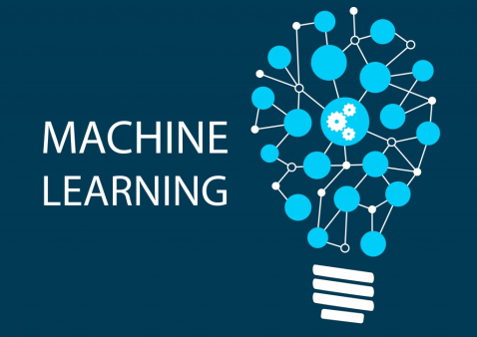




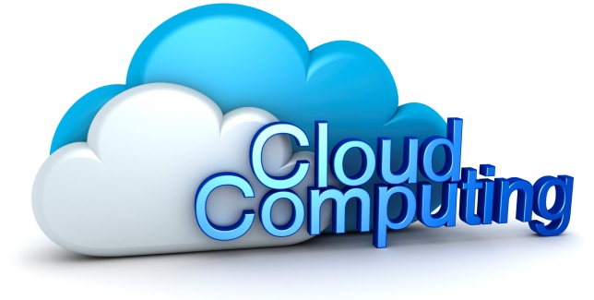



Stanford &

Slide 6
Training Roadmap
Fundamentals of Python
(2 Days)
Python for Data Science
(1 Day)
Fundamentals of Data Science
(1 Day)
Data Science : Deep Dive
(3 Days)
Fundamentals of
R Programming
(2 Days)
Data Science using
R Programming
(2 Days)
Fundamentals of
Machine Learning
(1 Day)
Machine Learning :
Deep Dive
(2 Days)
Code Free
Fundamentals of AI,ML & DS (1 Day)
Fundamentals of
Deep Learning
(1 Day)
TensorFlow : Deep Dive
(2 Days)
AI,ML & Data Science
Keras : Deep Dive
(2 Days)
Big Data
Fundamentals of Big Data
(1 Day)
Big Data : Deep Dive
(3 Days)
Cloud Computing
Fundamentals of Cloud Computing
(1 Day)
Google Cloud Platform
Deep Dive (3 Days)
Amazon Web Services
Deep Dive (3 Days)
Microsoft Azure
Deep Dive (3 Days)
Visualization & Reporting
Tableau Desktop : Beginners
(1 Day)
Tableau Desktop : Intermediate
(2 Days)
Visualization using Matplotlib
(1 Day)
Power BI : Intermediate
(2 Days)
No Coding to deep coding

Slide 7
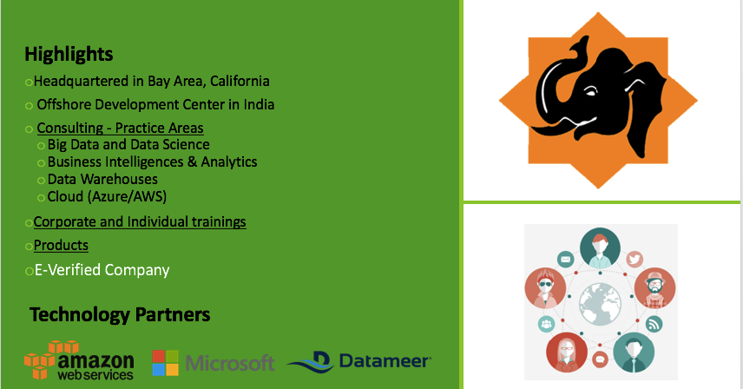
Big Data Trunk

Slide 8
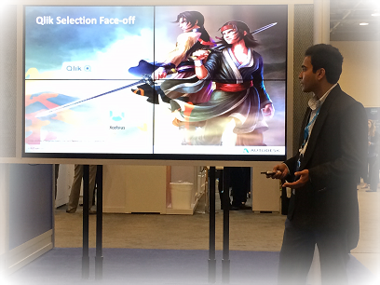

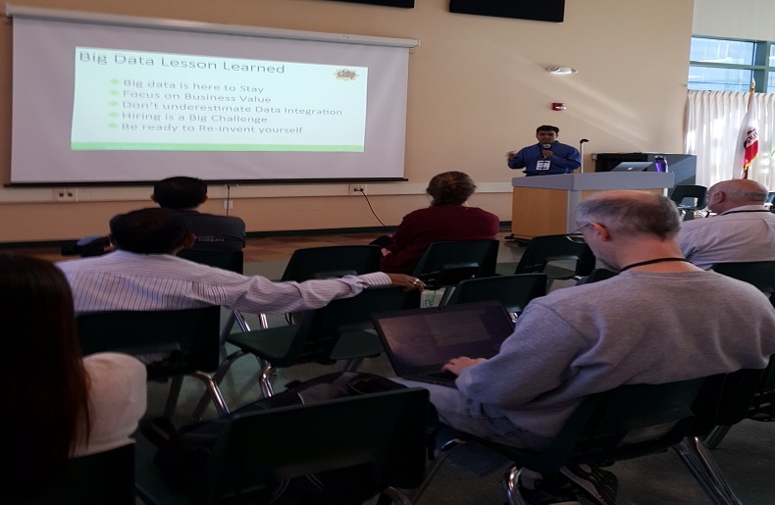
Introduction
Raju Shreewastava
21 yrs. in Data & Analytics
Resident of Fremont
Passion for teaching
Presented in several conferences

Slide 9
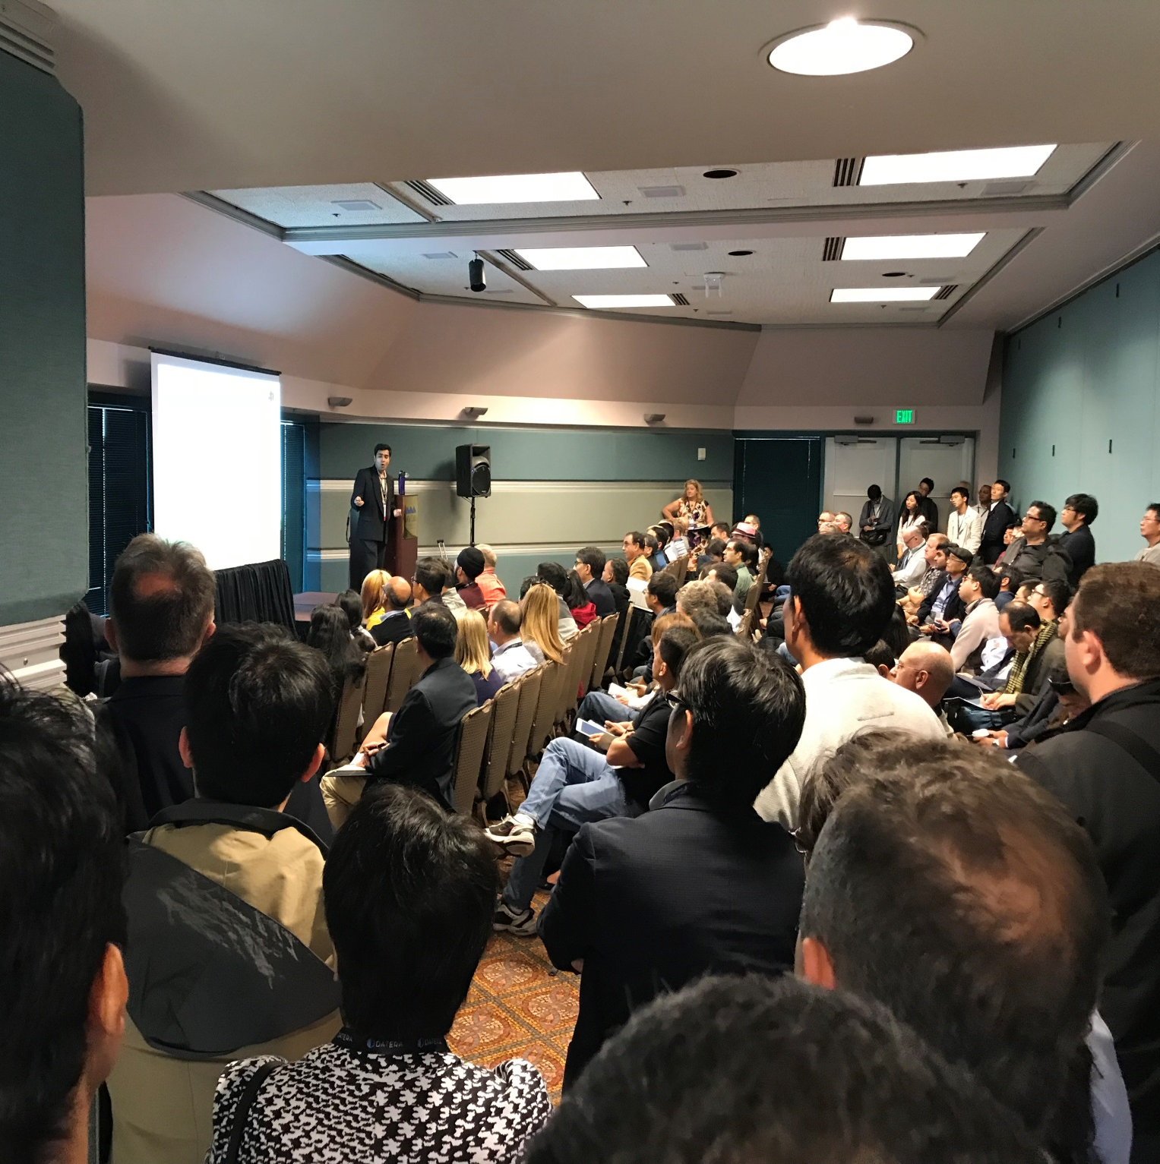
Cloud Expo
Machine Learning for Anyone and Everyone
Santa Clara Convention center

Slide 10
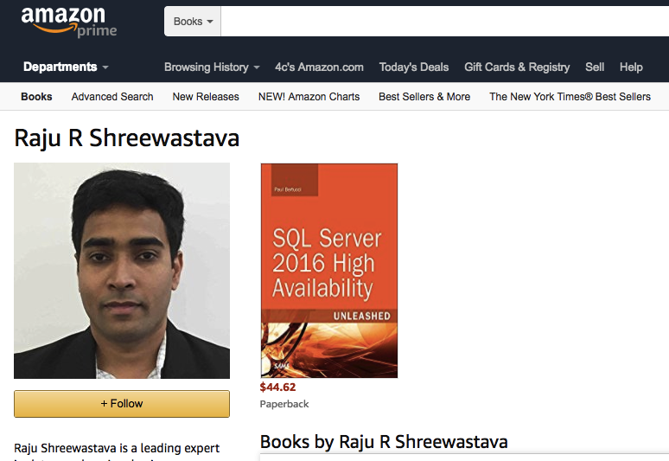

Author
Big Data High Availability (Pearson Publication)
Perform Data Engineering on Microsoft Azure HDInsight (Microsoft Press)

Slide 11
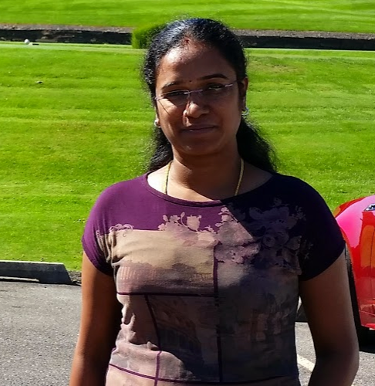
Introduction
Hema Sampath
14 years experience in Data Products/Analytics
Resident of Dublin, CA
Masters in Mathematics & Engineering Management
Love learning, sharing knowledge / teaching
Part of Big Data Trunk since 2017

Slide 12
Your turn
Who - Name, Role & Group
What is your Overall experience & Main Skill ( Any experience on this topic?)
Why are you here? (Key Motivations)
How are you planning to use this knowledge?

Slide 13
Any Questions?

Slide 14
Quiz 1
List few features of Tableau
List the Tableau Products / Offerings in the Market

Slide 15
Demo Time !!!

Slide 16
Hands On Creating your first report (Open the “Exercise 2 – Create your first report” document before you start the hands on work. Exercise 1 completion is a required pre-work for this exercise)

Slide 17
Quiz 2
1. Dimensions are calculatable values
(a) True (b) False
2. Name few data types supported in Tableau
3. Name the different types of Joins used in Tableau

Slide 18
Survey Time
http://ttseval.stanford.edu
Course Code – ITS-2566

Slide 19
Best Practices - Story Telling
Purpose of the Story (Trends / Drilling down the information/ Zooming out the story / Difference / Outliers / Factors / Shifts)
Keep it Simple
Fit into your Dashboards
Present in clear and uniform size
Execution time to be considered (avoid filters)
Know your data before presenting it to the customer

Slide 20
Demo Time !!!

Slide 21
Next steps
Practice the Hands On exercise on your own, using various options in the board
Use multiple type of graphs for same data analysis
Practice using the data available in tableau public workspace resources in https://public.tableau.com/en-us/s/resources
Practice more using the data available in Data.gov
Attend the intermediate training to know more about Tableau, Calculations, More connectors, Tableau Public

Slide 22
Book Recommendations
Book | Author
Practical Tableau: 100 Tips, Tutorials, and Strategies from a Tableau Zen Master | Ryan Sleeper
Tableau for Dummies | Molly Monsey and Paul Sochan
Information Dashboard Design: Displaying Data for At-a-Glance Monitoring | Stephen Few
Beautiful Visualization: Looking at Data through the Eyes of Experts | Julie Steele, Noah Iliinsky

Slide 23
Data Training Roadmap
Fundamentals of Python
(2 Days)
Python for Data Science
(1 Day)
Fundamentals of Data Science
(1 Day)
Data Science : Deep Dive
(3 Days)
Fundamentals of
R Programming
(2 Days)
Data Science using
R Programming
(2 Days)
Fundamentals of
Machine Learning
(1 Day)
Machine Learning :
Deep Dive
(2 Days)
Code Free
Fundamentals of AI,ML & DS (1 Day)
Fundamentals of
Deep Learning
(1 Day)
TensorFlow : Deep Dive
(2 Days)
AI,ML & Data Science
Keras : Deep Dive
(2 Days)
Big Data
Fundamentals of Big Data
(1 Day)
Big Data : Deep Dive
(3 Days)
Cloud Computing
Fundamentals of Cloud Computing
(1 Day)
Google Cloud Platform
Deep Dive (3 Days)
Amazon Web Services
Deep Dive (3 Days)
Microsoft Azure
Deep Dive (3 Days)
Visualization & Reporting
Tableau Desktop : Beginners
(1 Day)
Tableau Desktop : Intermediate
(2 Days)
Visualization using Matplotlib
(1 Day)
Power BI : Intermediate
(2 Days)
No Coding to deep coding

Slide 24
Other Training Roadmap
Beginner's Guide to Mobile App Development
(1 Day)
Develop and Publish your first Android Mobile App (3 Days)
Mobile Application
Develop and Publish your first iOS Mobile App (3 Days)
Blockchain
Introduction to Blockchain Technology
(1 Day)
Blockchain for Developers
(3 Days)
HyperLedger for Developers
(2 Days)
No Coding to deep coding

Slide 25
Stanford Upcoming Training
Click here for latest schedule

Slide 26
Thank you
www.BigDataTrunk.com

